Slide 1
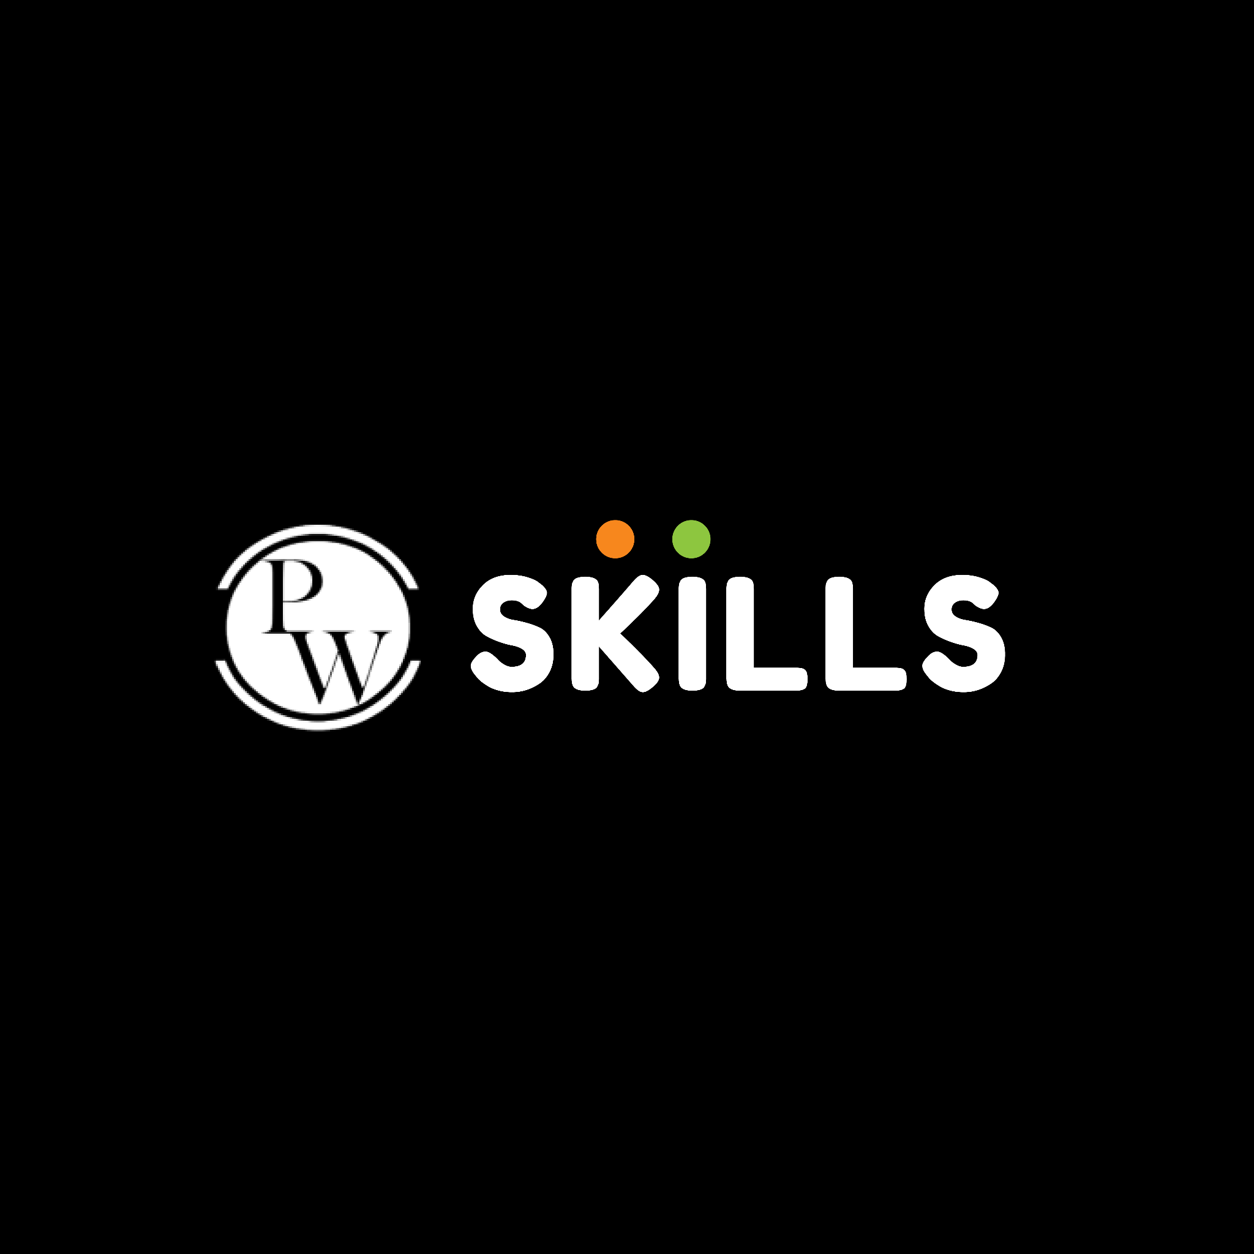

Working with transition, animation, and transform

Slide 2

Topics
Transition
Animation
Transform

Slide 3
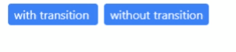
Transition
Transition Properties
Transitions in CSS are used to create smooth animations between different states of an element. In Tailwind CSS, you can apply transitions using the transition utility class along with other classes to control the duration, timing function, and delay.
Syntax:
Example:
transition-{properties}
<a
href="#"
class="mx-2 bg-blue-500 hover:bg-blue-700 px-2 py-1 text-white rounded transition"
>
with transition
</a>
<a
href=""
class="bg-blue-500 hover:bg-blue-700 px-2 py-1 text-white rounded"
>without transition</a
>
OUTPUT:

Slide 4
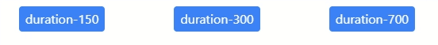
Transition
Transition Duration
The duration property class in Tailwind CSS is used to control the duration of a transition, which is the amount of time it takes for the transition to complete. By setting the duration, you can control how fast or slow the transition occurs when an element's state changes.
Syntax:
Example:
duration-{value}
<button
href="#"
class="bg-blue-500 hover:bg-red-700 px-2 py-1 text-white rounded transition duration-150"
>
duration-150
</button>
<button
href="#"
class="bg-blue-500 hover:bg-red-700 px-2 py-1 text-white rounded duration-300"
>
duration-300
</div>
<button
href="#"
class="bg-blue-500 hover:bg-red-700 px-2 py-1 text-white rounded duration-700"
>
duration-700
</button>
OUTPUT:

Slide 5
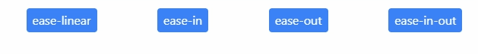
Transition
Transition Timing Function
The transition timing function is a property that determines how the intermediate states of a transition are calculated over time. It controls the acceleration and deceleration of the transition animation, giving it a specific easing effect. Tailwind CSS provides utility classes to define various timing functions. By default, if you don't specify a timing function, the transition will have a linear timing function. This means that the transition progresses evenly from the starting state to the ending state
Syntax:
Example:
ease-{type}
<button
href="#"
class="bg-blue-500 hover:bg-red-700 px-2 py-1 text-white rounded duration-300 ease-linear"
>
ease-linear
</button>
<button
href="#"
class="bg-blue-500 hover:bg-red-700 px-2 py-1 text-white rounded duration-300 ease-in"
>
ease-in
</div>
<button
href="#"
class="bg-blue-500 hover:bg-red-700 px-2 py-1 text-white rounded duration-300 ease-out"
>
ease-out
</button>
<button
href="#"
class="bg-blue-500 hover:bg-red-700 px-2 py-1 text-white rounded duration-300 ease-in-out"
>
ease-in-out
</button>
OUTPUT:

Slide 6
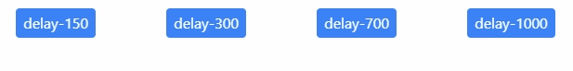
Transition
Transition Delay
Transition delay is a property that allows you to specify a delay before a transition starts. It controls the time between the change in the CSS property and the beginning of the transition animation. In Tailwind CSS, you can use utility classes to define transition delays.
Syntax:
Example:
delay-{value}
<button
href="#"
class="bg-blue-500 hover:bg-red-700 px-2 py-1 text-white rounded duration-300 ease-in-out delay-150"
>
delay-150
</button>
<button
href=""
class="bg-blue-500 hover:bg-red-700 px-2 py-1 text-white rounded duration-300 ease-in-out delay-300"
>
delay-300
</div>
<button
href=""
class="bg-blue-500 hover:bg-red-700 px-2 py-1 text-white rounded duration-300 ease-in-out delay-700"
>
delay-700
</button>
<button
href=""
class="bg-blue-500 hover:bg-red-700 px-2 py-1 text-white rounded duration-300 ease-in-out delay-1000"
>
delay-1000
</button>
OUTPUT:

Slide 7
Animation
Tailwind CSS comes with a set of pre-built animation utility classes that you can apply to your HTML elements. These classes allow you to achieve various animation effects without writing CSS or JavaScript code.
Syntax:
Example:
animate-{type}
<button
href="#"
class="bg-blue-500 hover:bg-red-700 px-2 py-1 text-white rounded duration-300 ease-in-out delay-150"
>
delay-150
</button>
<button
href=""
class="bg-blue-500 hover:bg-red-700 px-2 py-1 text-white rounded duration-300 ease-in-out delay-300"
>
delay-300
</div>
<button
href=""
class="bg-blue-500 hover:bg-red-700 px-2 py-1 text-white rounded duration-300 ease-in-out delay-700"
>
delay-700
</button>
<button
href=""
class="bg-blue-500 hover:bg-red-700 px-2 py-1 text-white rounded duration-300 ease-in-out delay-1000"
>
delay-1000
</button>
OUTPUT:

Slide 8

Animation
Spin
you can add the animate-spin class to make an element spin continuously
Example:
animate-spin
<div class="flex items-center px-3 py-1 bg-blue-600 text-white rounded">
Loading
<img
class="animate-spin"
width="30"
height="30"
src="https://img.icons8.com/fluency-systems-filled/48/spinner-frame-5.png"
alt="spinner-frame-5"
/>
</div>
OUTPUT:

Slide 9
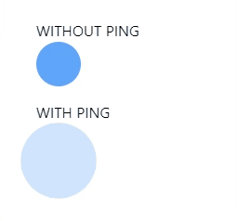
Animation
Ping
Add the animate-ping utility to make an element scale and fade like a radar ping or ripple of water
Example:
animate-ping
<h2>WITHOUT PING</h2>
<div class="h-12 w-12 rounded-full bg-blue-400 mb-4"></div>
<h2 class="mb-4">WITH PING</h2>
<div
class="animate-ping duration-2000 h-12 w-12 rounded-full bg-blue-400"
></div>
OUTPUT:

Slide 10

Animation
Pulse
The "animate-pulse" animation in Tailwind CSS is a simple way to add a pulsating effect to elements on your web page.
Example:
animate-ping
<div class="border px-2 py-2 animate-pulse">
<h2 class="font-bold">PW Skills</h2>
<p>This is a sample code for you to show how animate-pulse works</p>
</div>
OUTPUT:

Slide 11
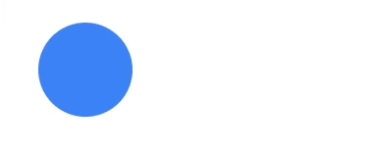
Animation
Bounce
The "animate-bounce" animation in Tailwind CSS is a simple way to add a bouncing effect to elements on your web page
Example:
animate-ping
<div class="bg-blue-500 rounded-full w-24 h-24 animate-bounce"></div>
OUTPUT:

Slide 12
THANK YOU

